Slide 1

Student Details
Name. : Kongarani lavanya
email id : lavanyakongarani7799@gmail.com

Slide 2
employee burn out prediction
Employee burnout is a state of physical, emotional and mental exhaustion caused by excessive and prolonged stress.
It can have serious in individual well-being and can lead to decrease productivity and job performance in today’s fast-paced and constantly connected world it is increasingly important to recognize and address the signs of burnout in order to maintain the health and well-awing of employees we will be storing the use of regression sectaries to predict employee burnout.
By analyzing a dataset containing various factors that may contribute to burnout such as workload, mental fatigue job and work de silence, we can develop a model to identify individuals who may be at nook of burnout.
By analysing a dataset containing various factors that may contribute to Burnout such as workload, mental fatigue job and work de silence, we can develop a model to identify individuals who may be at not of Burnout. By proactively addressing these nok factors, organizations can bold prevent Burnout and promote the well-being of their employees

Slide 3
AGENDA
Provide stress management interventions.
Allow employees to be active crafters of their work
Cultivate and encourage social support
Engage employees in decision-making
Implement high-quality performance management
Provide strengths-based feedback that is timely, frequent, specific, verifiable, consistent, and has consequences
Implement fair and equitable performance management

Slide 4
PROJECT OVERVIEW
The survey has been conducted among the employees of IT organizations in Bangalore As it is stated that the minimum sample size should be of 385 respondents so on basis of those 500 forms has been distributed targeting small and big giants of IT organizations.
This distribution has been done personally as well as online through internet. After the long procedure of distribution, filling and collecting back forms it is found that 436 respondents after excluding non fillers, double tickers, double writing etc.
In these respondents 67.97 percent is male and 32.03 percent is female
Burning out of employee is creating serious problems for employees as well as organization as a whole.
The main impact of employee burnout is low productivity, poor employee morale and high employee turnover cost .

Slide 5
WHO ARE THE END USERS of this project?
Employees are the end users in employee burnout.
Industry experts indicate that most organizations do not have a solid understanding of what is involved in IT work or in advancing an IT career
Consideration of the current IT environment might reveal those factors that are most relevant to IT professionals. The current IT environment is characterized by rapid change and increased globalization.
The main purpose of this study is to examine and assess the main reasons for stress and depression of employees in IT sector.
In addition, the present research effort addresses limitations of existing burnout literature.

Slide 6
YOUR SOLUTION AND ITS VALUE PROPOSITION
Distribute workloads evenly across employees and monitor scheduling to avoid burnout and increase productivity.
Create a supportive work environment that encourages open communication and collaboration. This can include scheduling regular meetings to offer guidance, starting a mentorship program, and providing regular feedback.
Make employees feel appreciated for their efforts by recognizing their work. This can help prevent employees from working long hours or not taking time off.
Provide structure through daily or weekly planning to help employees find balance between work and relaxation.
Prioritize workplace wellness by applying positive psychology principles to the workplace to make work more enjoyable and fulfilling

Slide 7
How did you customize the project and make it your own
Performed a simplified EDA to understand the dataset, including the number of instances and attributes, attribute types, constant or unnecessary columns, missing values, problem type (classification or regression), and whether the dataset is imbalanced.
Divided the data into a training set for model training and hyperparameter tuning, and a test set for evaluation.
Used stratified partitioning and appropriate metrics for imbalanced classification problems, such as balanced_accuracy, f1, and confusion matrix.
Used pipelines for preprocessing and considered using external libraries like colab
By understanding the factors contributing to burnout and developing prediction models, we aim to identify at-risk employees and provide targeted support.

Slide 8

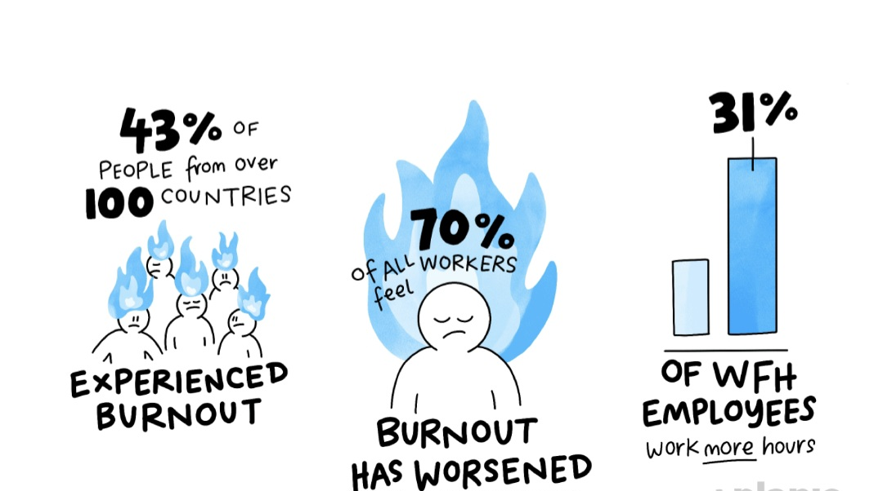
MODELLING

Slide 9
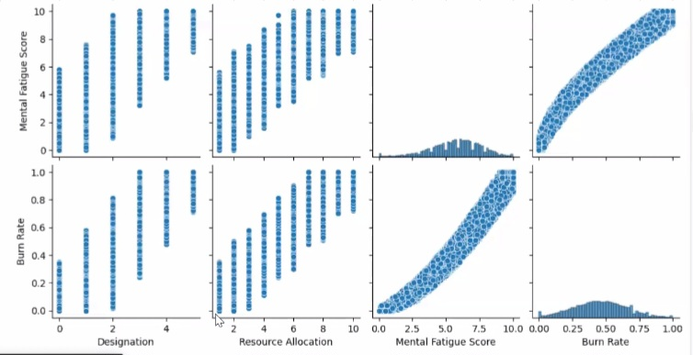
Results

Slide 10
links
Colab
Google.com
Jupiter

